Slide 1
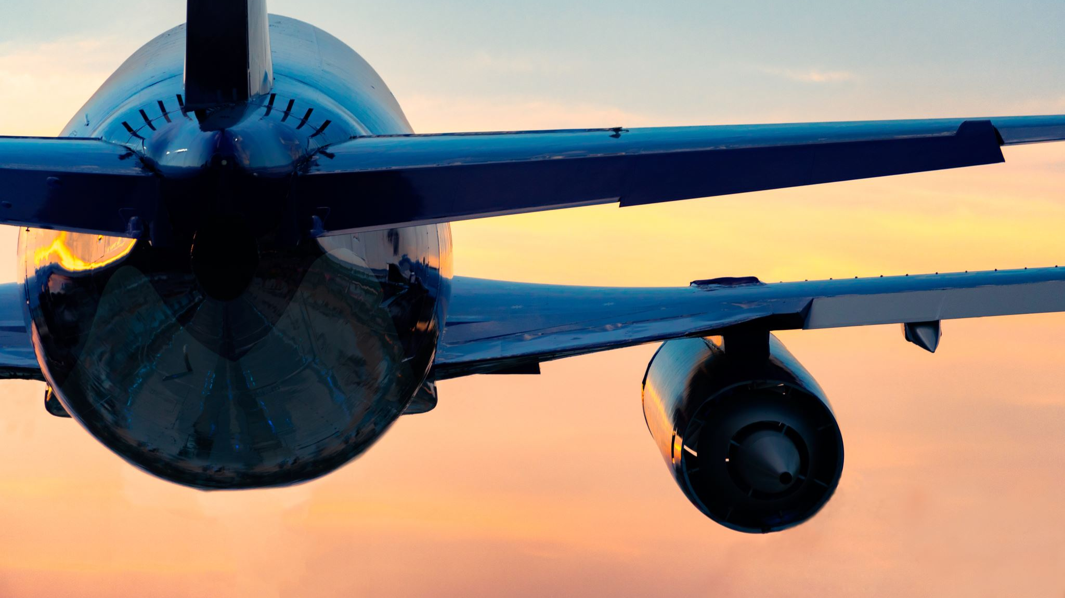

Lufthansa Airlines Say Yes to the World
Shaquiel Pashtunyar
DSC640

Slide 2
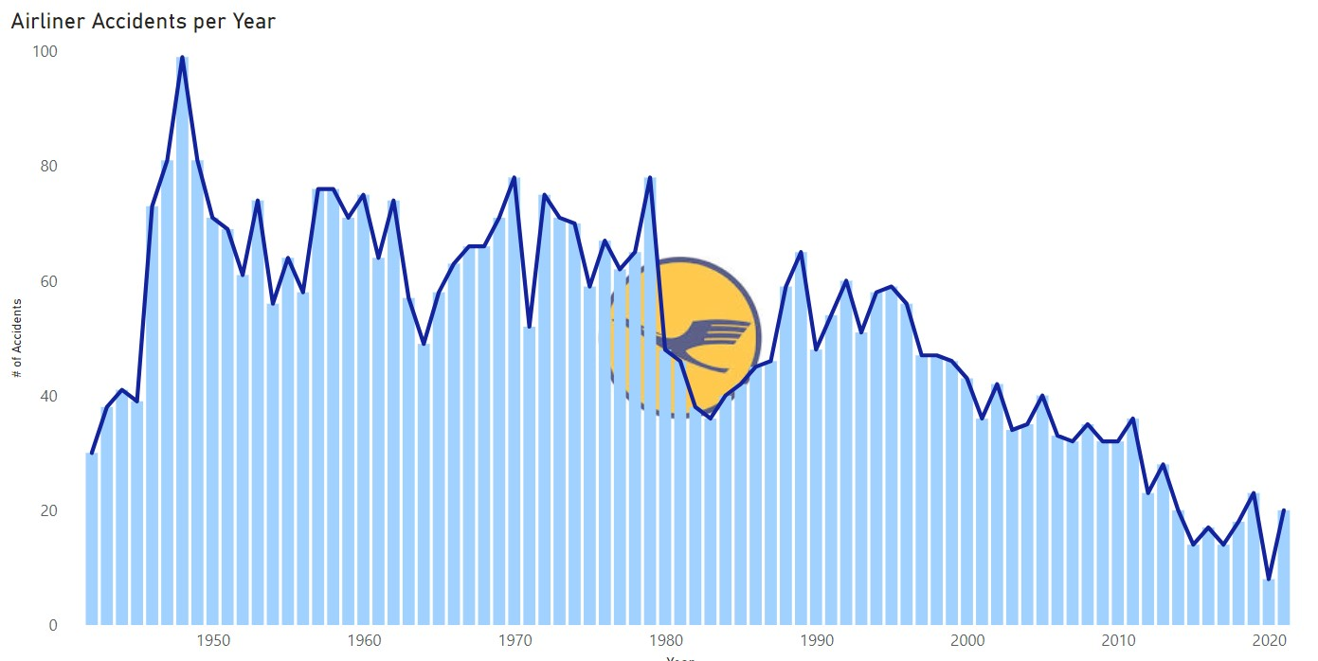
The skies are safer than ever

Slide 3
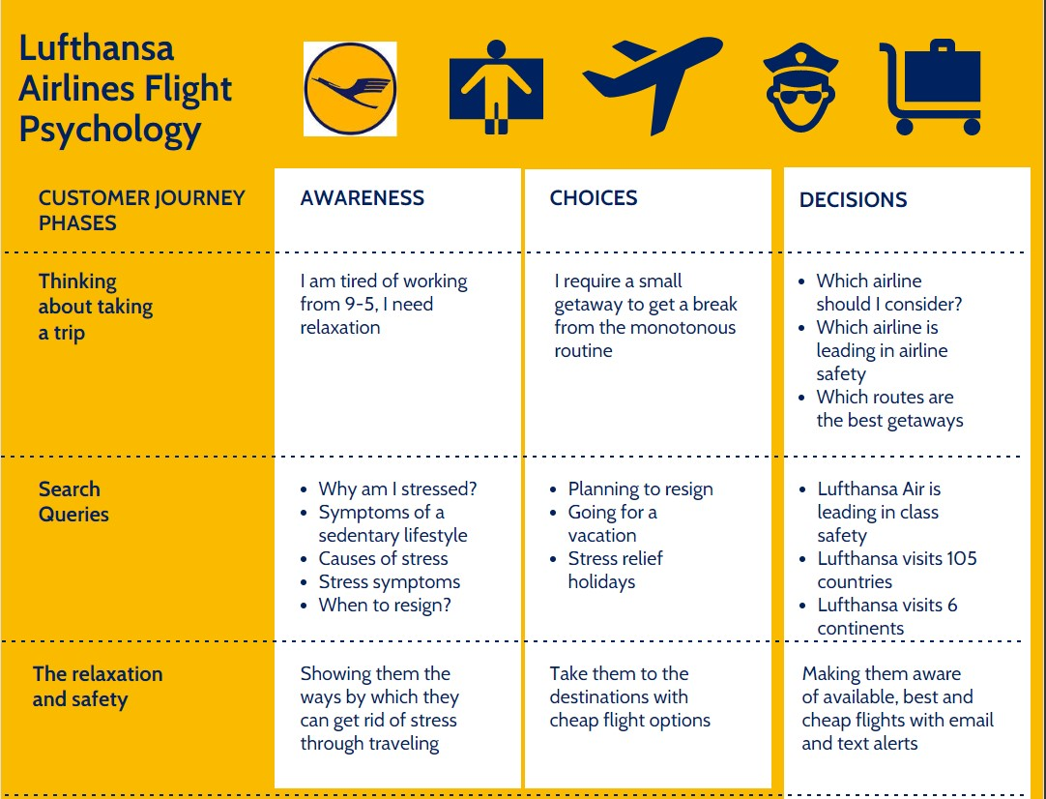

Slide 4
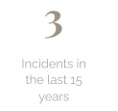
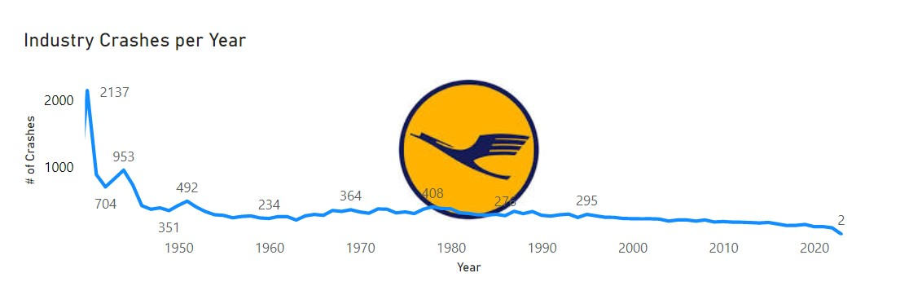
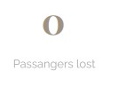
Lufthansa is an industry leader

Slide 5

Join us today!
Airways Customer Journey Map - by Shaq Pash [Infographic]
https://shaqpash.wixsite.com/my-site
https://www.lufthansa.com/us/en/homepage
Say Yes to the World
Resources for the data provided:
Accident and fatalities per year data set csv
https://knaviation.net/is-lufthansa-safe/
​https://www.flight-delayed.com/blog/2019/01/16/which-airlines-fly-to-the-largest-number-of-countries

